Slide 1
Digital Portfolio
STUDENT NAME:Amsaprasanna.p
REGISTER NO AND NMID: B80181821E87637BBF54598F9383A304
DEPARTMENT: BCA
COLLEGE: VALLIAMMAI WOMEN’S COLLEGE
UNIVERCITY:ANNAMALAI UNIVERCITY

Slide 2
PROJECT TITLE
The project title is a concise and descriptive name that captures the essence of your project.When choosing a project title, consider:1. Clarity2. Relevance3. Creativity4. MemorabilityWhat kind of project are you working on? I'd be happy to help you brainstorm a title!

Slide 3


AGENDA
Problem Statement
Project Overview
End Users
Tools and Technologies
Portfolio design and Layout
Features and Functionality
Results and Screenshots
Conclusion
Github Link
3/21/2024 Annual Review

Slide 4

PROBLEM STATEMENT
A problem statement is a clear and concise description of a problem or challenge that needs to be addressed. It typically includes:1. Description of the problem2. Impact of the problem3. Goals or objectivesA well-defined problem statement helps guide the development of solutions and ensures everyone involved is working towards the same goal.Would you like to share a specific problem statement you're working on?

Slide 5

PROJECT OVERVIEW
To provide a project overview, I'll need more context. Could you please share:1. Project type (e.g., software, research, creative)2. Project goals3. Key stakeholders4. Current statusWith this info, I can help you summarize your project's main aspects.

Slide 6

WHO ARE THE END USERS?
The end-users are the individuals who will ultimately interact with or benefit from a product, service, or system. They are typically the target audience or customers.Examples of end-users include:1. Consumers using a mobile app2. Employees using a company's internal software3. Customers visiting a websiteUnderstanding end-users' needs, preferences, and behaviors is crucial for designing and developing effective solutions.

Slide 7

TOOLS AND TECHNIQUES
Tools and techniques refer to the methods, software, and technologies used to achieve a specific goal or complete a task.Some examples of tools and techniques include:1. Project management tools (e.g., Asana, Trello)2. Design tools (e.g., Adobe Creative Cloud, Figma)3. Development tools (e.g., coding languages, IDEs)4. Data analysis tools (e.g., Excel, Tableau)Techniques might include:1. Agile methodologies2. User experience (UX) design3. Data visualization4. Version control (e.g., Git)What specific tools and techniques are you interested in?

Slide 8
POTFOLIO DESIGN AND LAYOUT
Portfolio design and layout refer to the visual arrangement and organization of content in a portfolio, showcasing work, skills, and accomplishments.Key considerations:1. Visual appeal2. Clear navigation3. Content hierarchy4. Branding consistencyPopular portfolio layouts:1. Grid-based2. Minimalist3. Hero-image4. Storytelling-drivenWhen designing a portfolio, consider:1. Target audience2. Personal brand3. Showcase strongest work4. Easy to updateWould you like design inspiration or tips?
8

Slide 9
FEATURES AND FUNCTIONALITY
Features and functionality refer to the capabilities and characteristics of a product, system, or service.Features might include:1. User interface elements2. Functionalities (e.g., search, filtering)3. Integration with other tools4. Customization optionsFunctionality can encompass:1. Performance2. Security3. Usability4. ScalabilityWhen designing or evaluating features and functionality, consider:1. User needs2. Technical requirements3. User experience4. Competitive landscapeWhat specific product or system are you interested in discussing?

Slide 10

Github link
https://github.com/amsaprasanna2007
3/21/2024 Annual Review
10

Slide 11
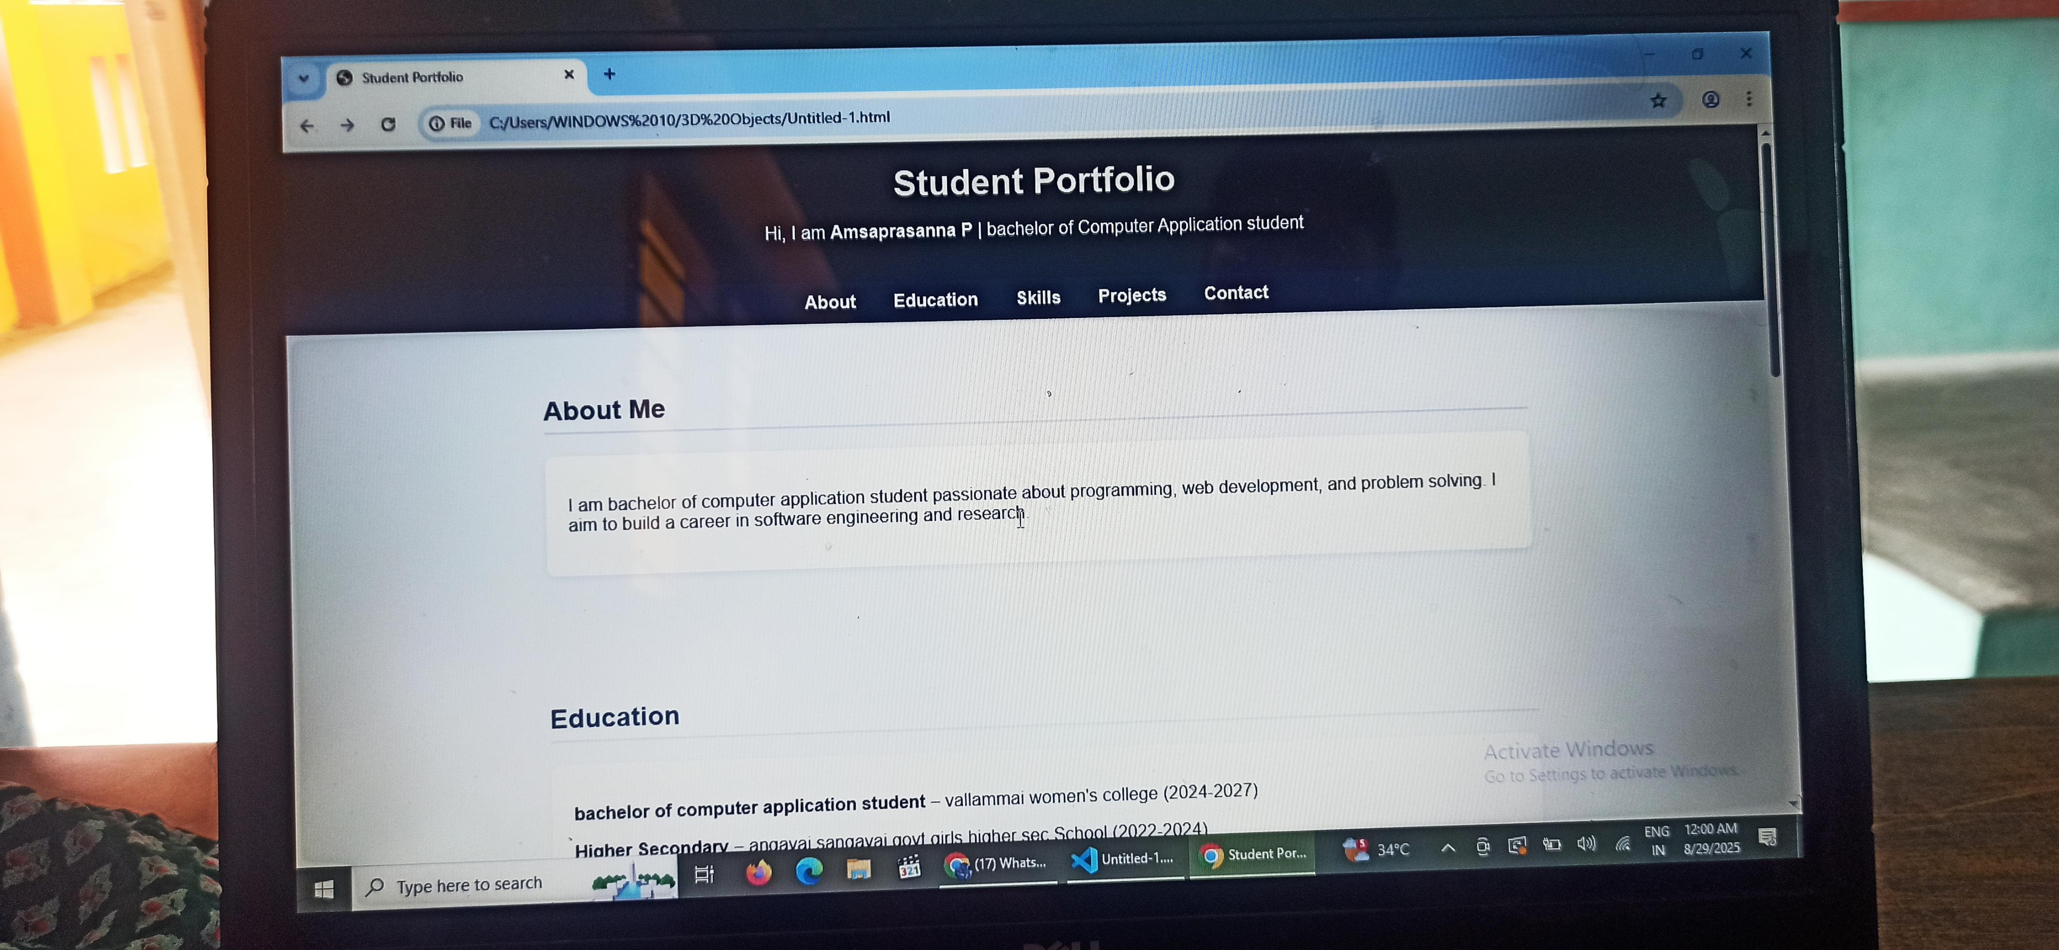

Slide 12
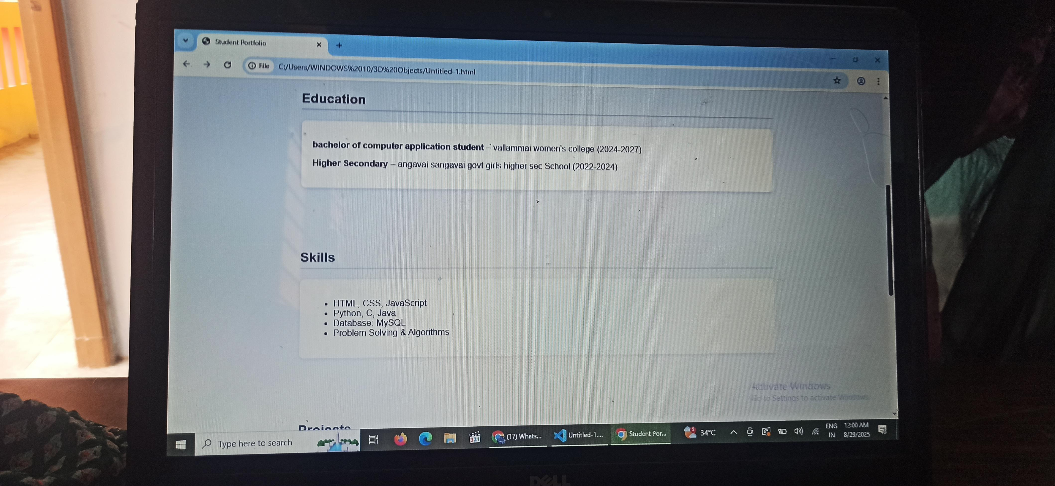

Slide 13
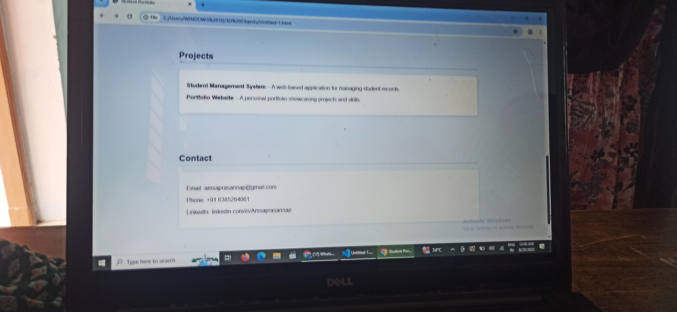

Slide 14
CONCLUSION
It seems like we've wrapped up our conversation! To conclude, what were your key takeaways or next steps? Want to explore more topics or revisit something we discussed? I'm here to help!
14

